Slide 1
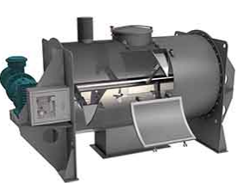
PLOUGH SHEAR MIXER
Mfg.& Exp. Of Plants & Machineries for Pharmaceuticals,
Cosmetics, Chemicals food & Beverage Industries
Plot No. 1601/1,3rd Phase G.I.D.C., Vapi-396195. (Gujarat)
Email:sales@sidhipharmaequiment.com:sidhipharmaequipments@gmail.com:
Contact Person : Mr. Pravin Panchal (9924893790) Mr. Kiran Gophane (9545868896)
Website: www.sidhipharmaequipment.com

Slide 2
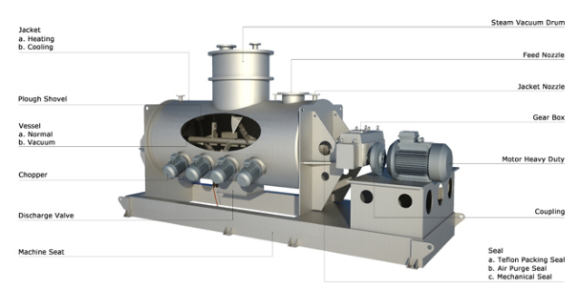
Plough Shear Mixer :
Plough Shear Mixer (also named ploughshare mixer, plow mixer, plough mixer) consists of a cylindrical drum containing plough shaped mixing elements that are mounted on a horizontal shaft. It creates a mechanical fluidized bed mixing action. The mixing tools project and hurl material away from the wall into free space in a crisscross direction, and inversely back again. The plow separates and lifts the product into three-dimensional motion, while the number and arrangement of the tools insure agitation back and forth along the length of the vessel. When required, the mix action is assisted by high speed chopper devices–independent high-speed motors with customized blades for adding shear to the product mix

Slide 3
Silent Features :
Petal type chopper, knife type chopper
Vacuum/Pressure inside mixer
Heating/Cooling Jacket for mixer
Spraying Nozzle for liquid
Various Outlet Valve depend on customer’s process requirement
Heavy-duty drive unit
Explosion-proof for electricity
Electrical Control Panel system
GMP manufacturing
Teflon Coating for material contact part
Abrasion resistance treatment
Other Special Customize Design
Advantageous\ Benefits :
High Speed and Homogenous Mixing
Wide Range of Applications
Short Mixing Time
Easy to Clean
Avoid Agglomeration

Slide 4
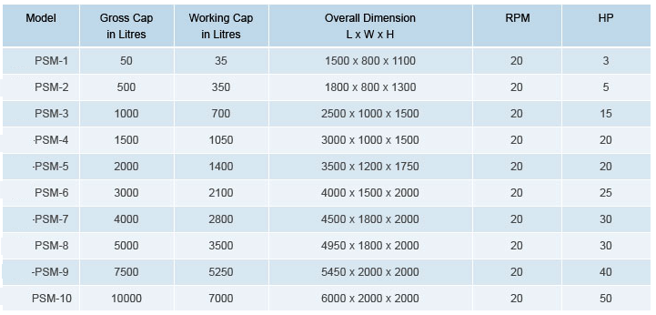
Technical Specification :
Single Source Provider for all your technical requirements.
One of the most important “Siddhi Pharma Equipment” guideline is to be closest to our Customers. We strive to create end-to-end solutions that meet our clients needs and their expectation.
Application :
Pharmaceutical
Food
Chemical
Cosmetics
Allied Industry

